Slide 1
Reporting the test result
To Parents

Slide 2
Introduction
Of all the bridges between the School and community the Report to Parents is the oldest and most widely used.
It is the commonest mean of communication between the school and the home.

Slide 3
Importance
Reporting to Parents can be one of the most useful instruments for the personalizing of education and the guidance of pupils.
Reports influence the pupil’s idea of himself- they often determine whether he regards himself as a failure or as a success.

Slide 4
Reports also influence the parents’ attitude toward the child and the school.
Accurate and diagnostic reports invite parents to participate in the education of their Children.
Reports suggest to teachers and administrators the need of change in the curriculum.

Slide 5
Reports shows the progress of the class and individual
It gives the teacher new insights into
his method of teaching and lead to improved instruction.
The effective report will give parents confidence in the teacher’s ability and will assure them that their children are being treated as individuals.

Slide 6
The type of norms to use reporting to Parents
Percentile ranks
Grade Equivalents
IQ’s and mental Ages

Slide 7
Percentile Ranks
Percentile ranks relate the individual’s result to those of all students who took the same test.
A percentile rank of 50 means the student performed better then 50% of the children her who took the same test.

Slide 8
Formula
Cl+0.5fi/N*100
Cl is the count of all scores less then the score of interest
Fi is the frequency of the score of interest
N is the no of examinees

Slide 9
Grade Equivalents
5.3
??

Slide 10
When you see 5.3 it means the position of student of 5th grade after the third month of school.
If your 5th grade child score an average score compared to this sample group at the same time of year, then she is said to be functioning at the “5.3’’
But if , your Child score much higher than average, her GE score will be reported higher

Slide 11
If she received “6.2”, it means that she scored about the same as the 6th grade student scored in second month of their grade.
It doesn't mean that she was tested on 6th grade material, but was tested on 5th grade material and did better the average of 5th grader in the sample group

Slide 12
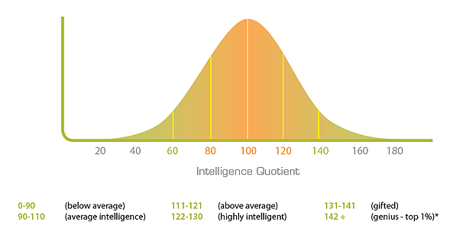
IQ’s
IQ tests calculate a person's intelligence quotient score, which is based on a relative scale, measured against an age-based average score

Slide 13
Formula
MA CA 100
MA Mental Age
CA Chronological Age

Slide 14
Any Question???

